Slide 1
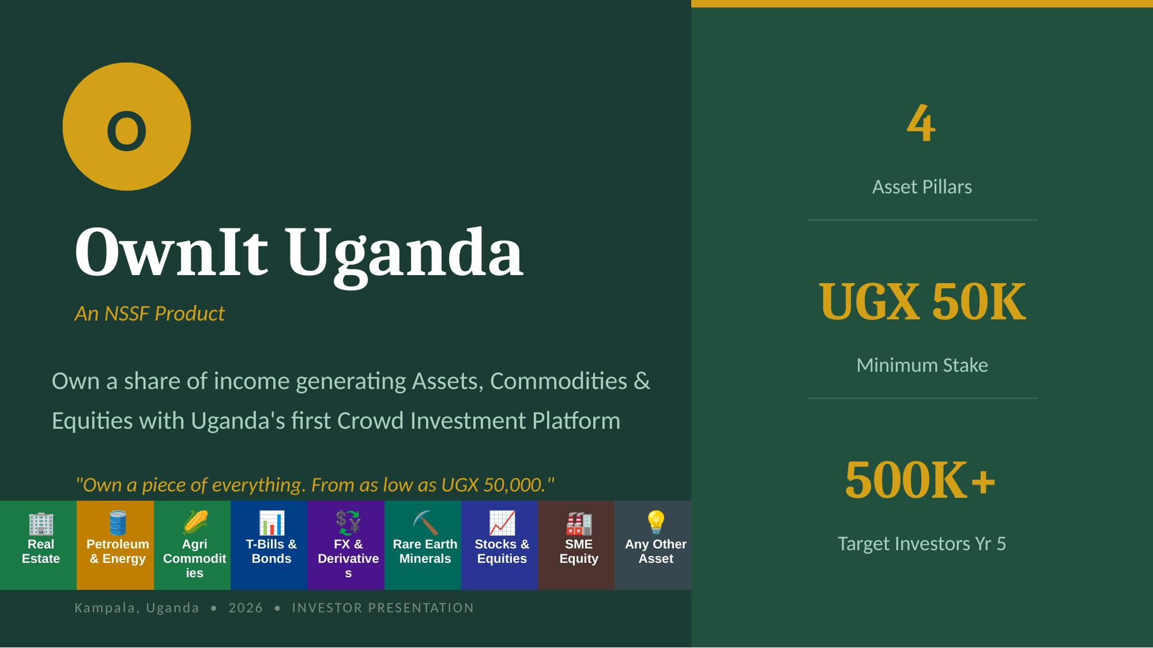

Slide 2
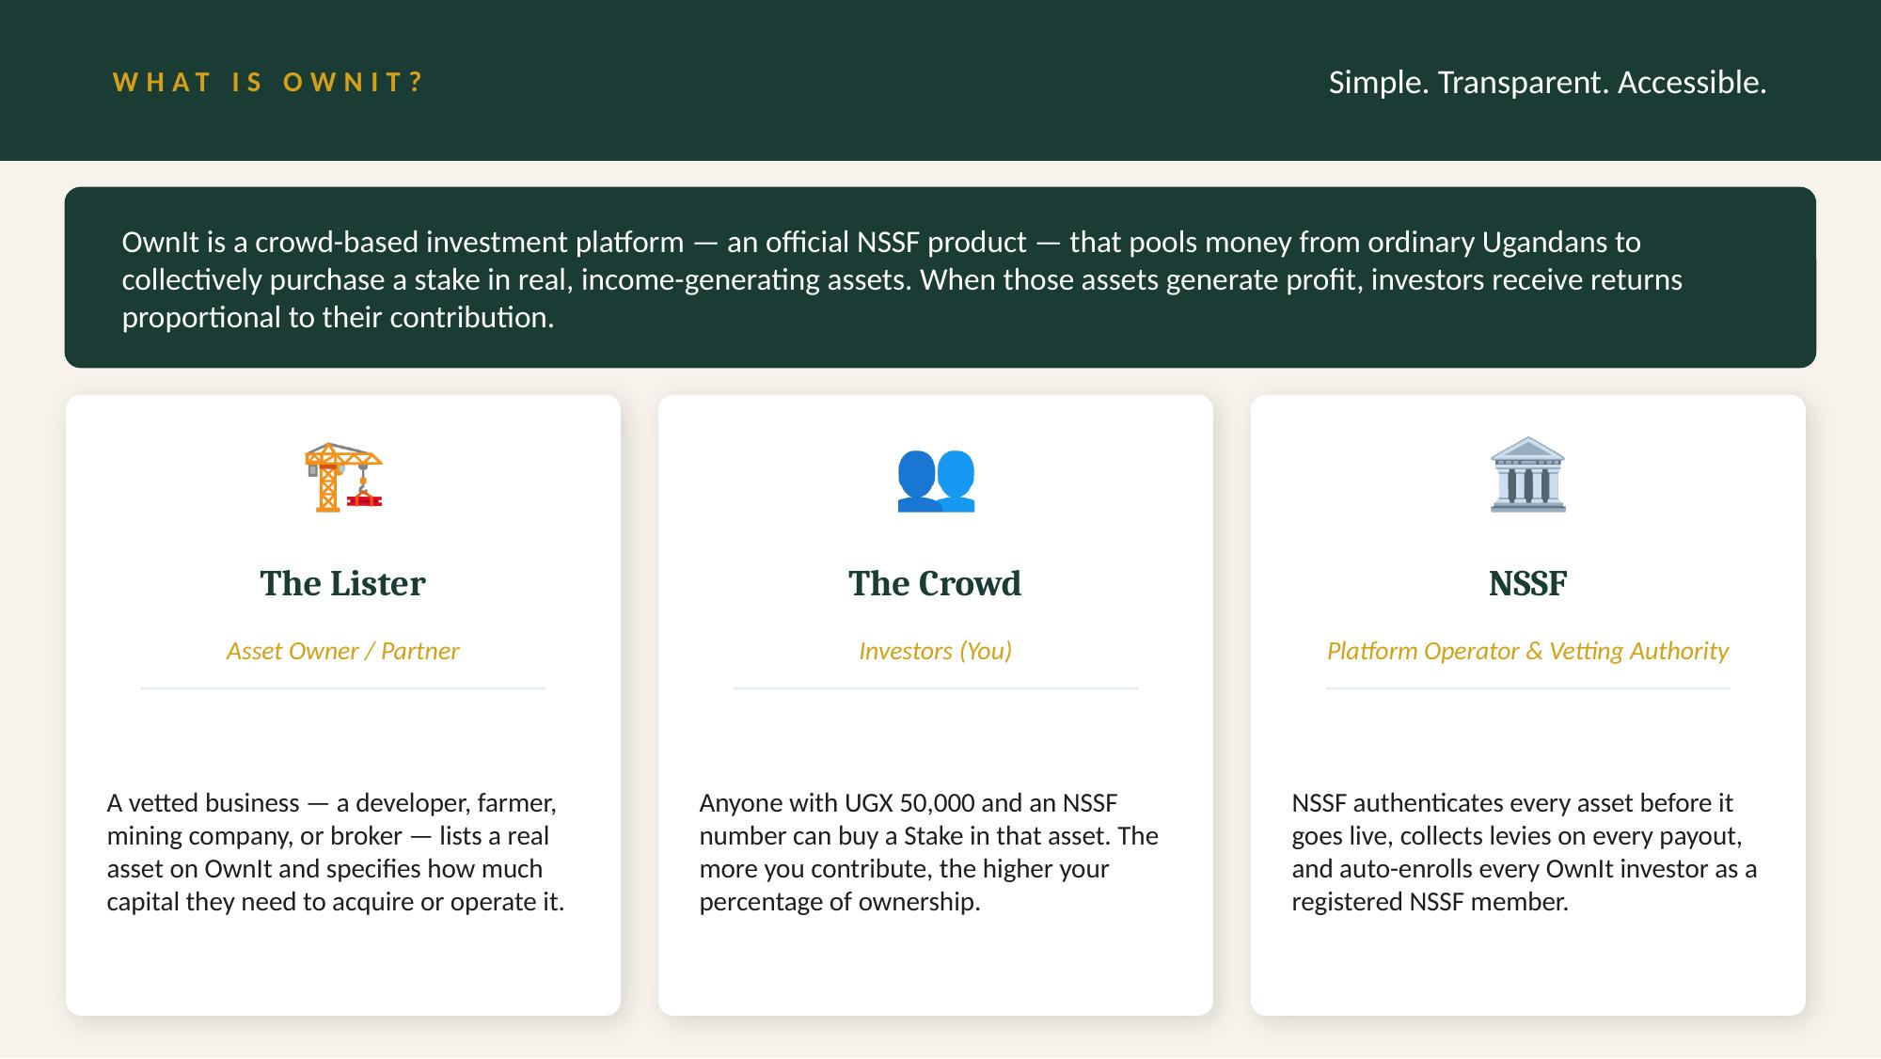

Slide 3




THE PROBLEM
80% of Uganda's workers are locked out of wealth creation
High entry barriers
Mobile-first, product-last
T-Bills, property, and commodity trading require UGX 1M+. Most Ugandans are permanently priced out.
Uganda has 30M+ Mobile Money accounts — yet zero crowd-investment products are natively built on mobile money.
Wrong time horizons
Profits stay at the top
80% of Uganda's workforce is informal. They cannot lock savings for 5+ years — they need returns within months.
Bond yields of 16–18%, agri margins of 25–45%, mineral export margins of 20–60%. Only institutions and high networth individuals benefit.
NSSF has ~3.4M active members from a 14M+ workforce — below 15% penetration. Its 2035 target of 15M members is at risk without a breakthrough product.

Slide 4
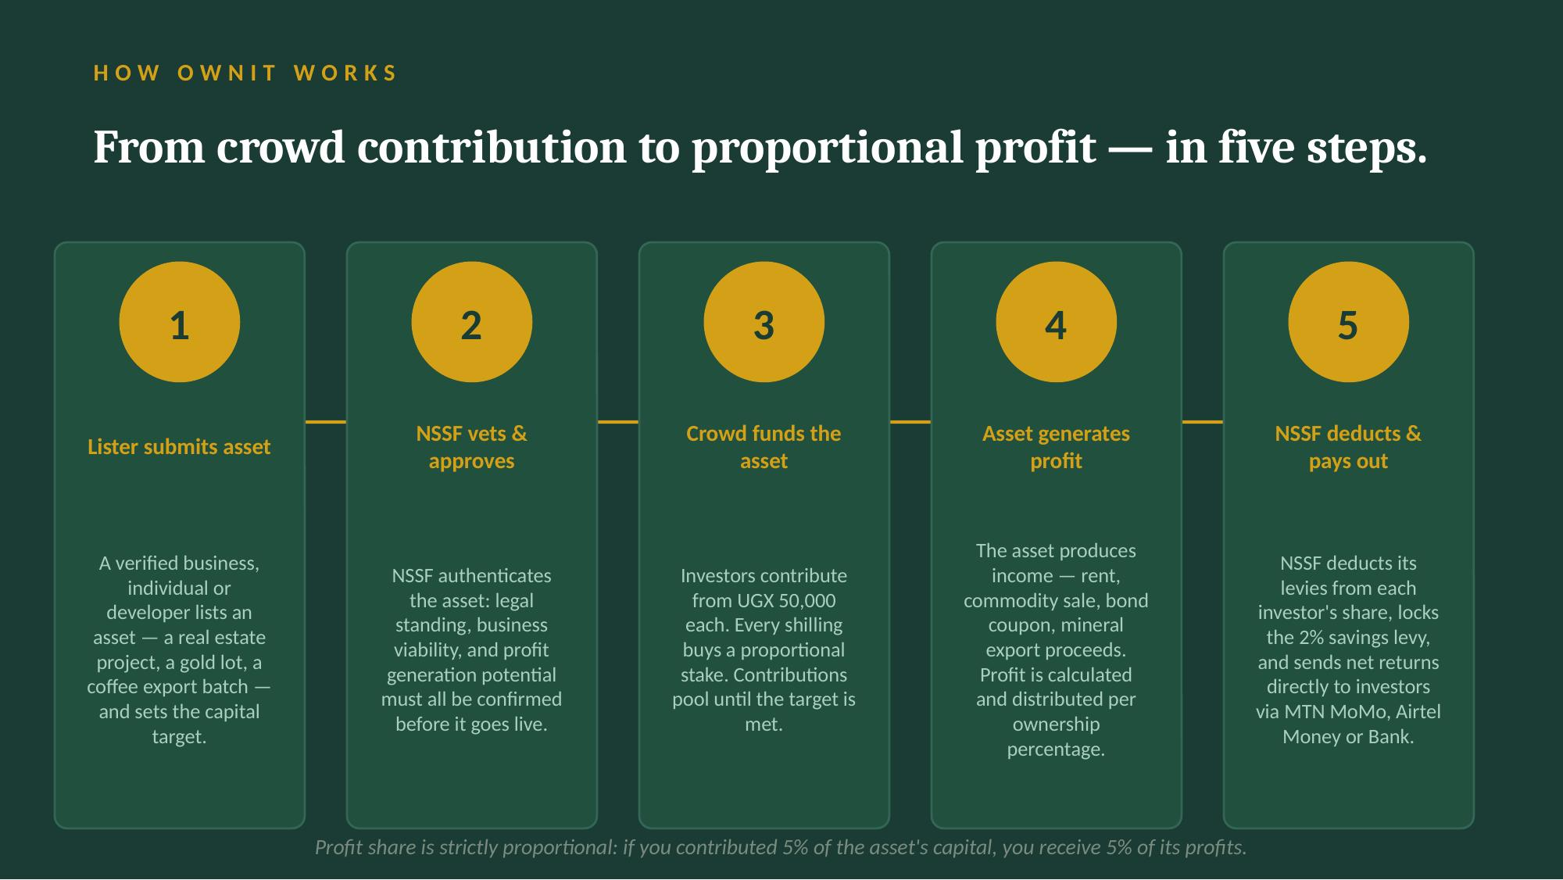

Slide 5
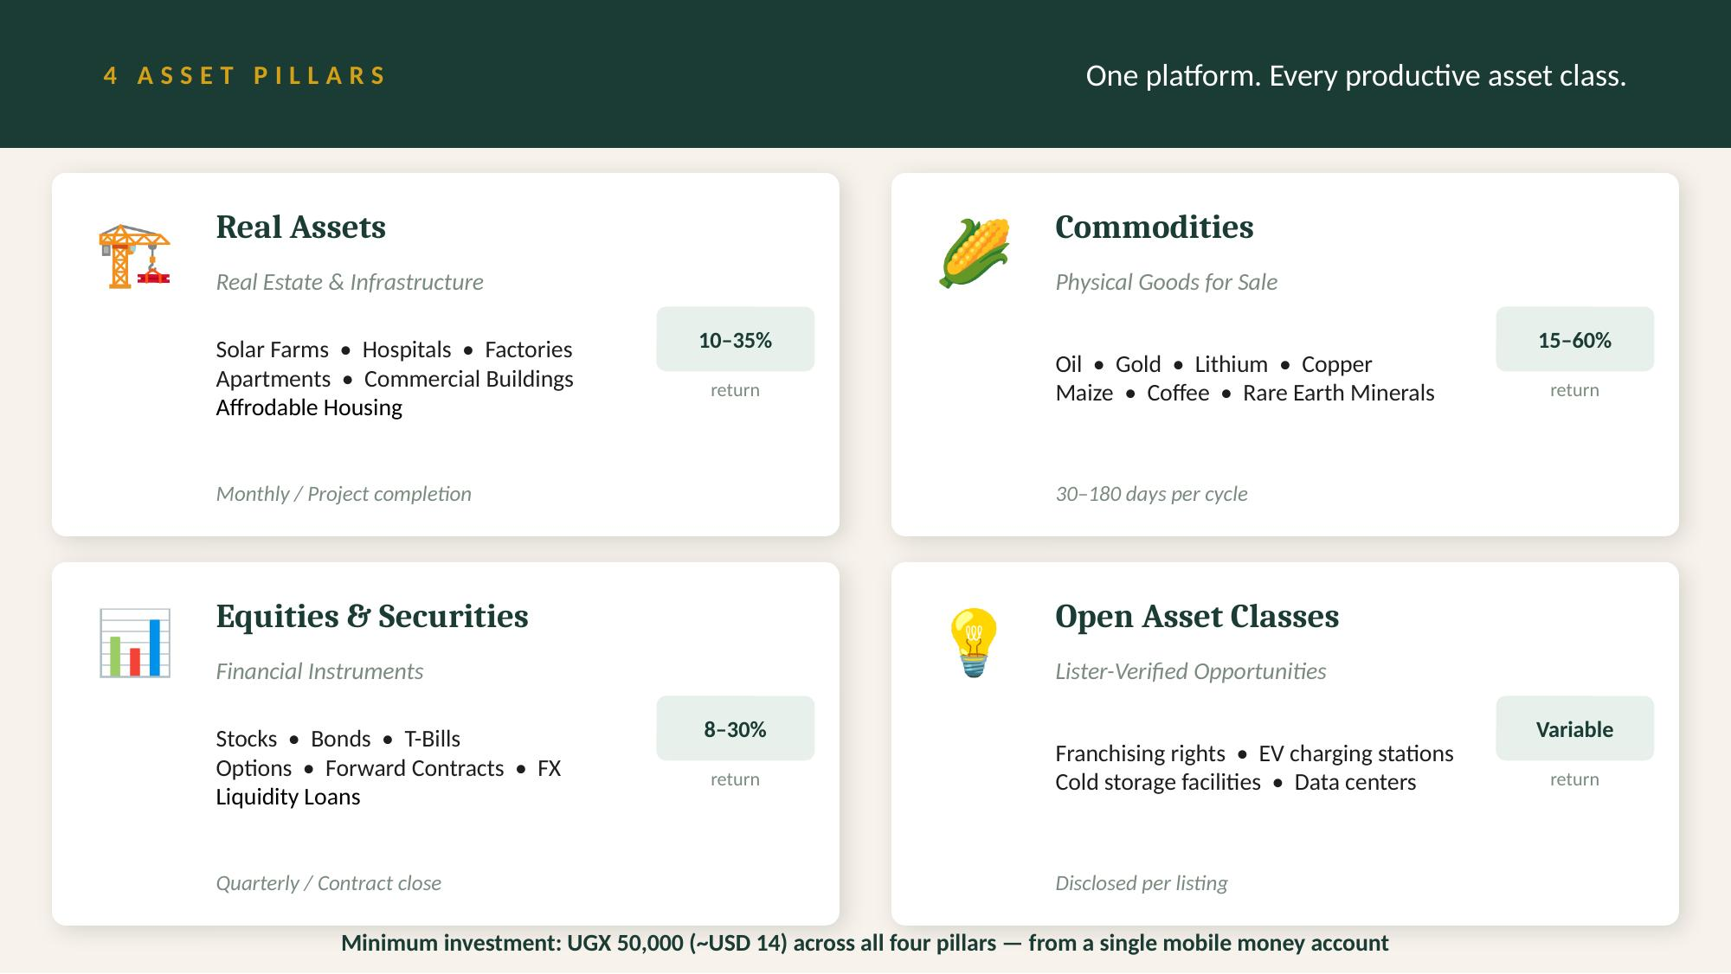

Slide 6
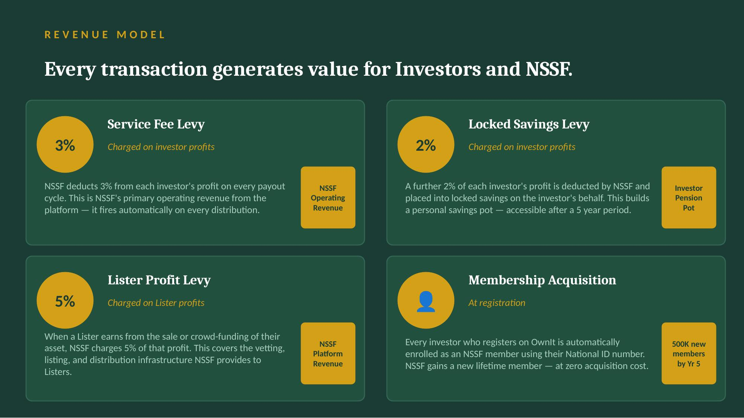

Slide 7
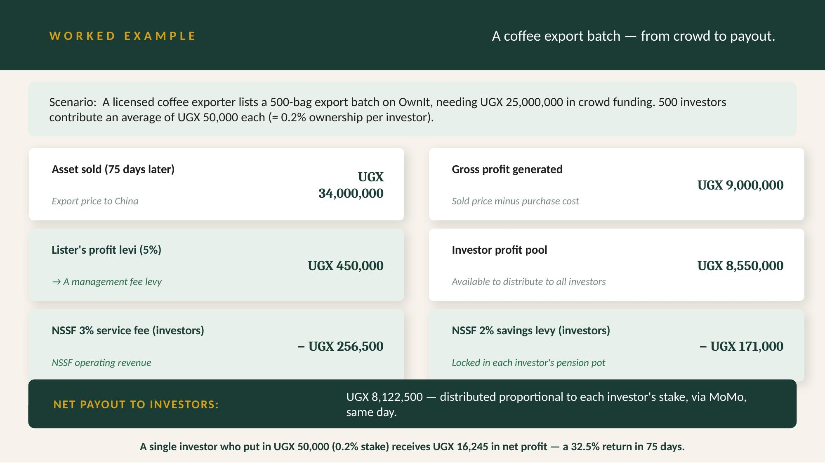

Slide 8
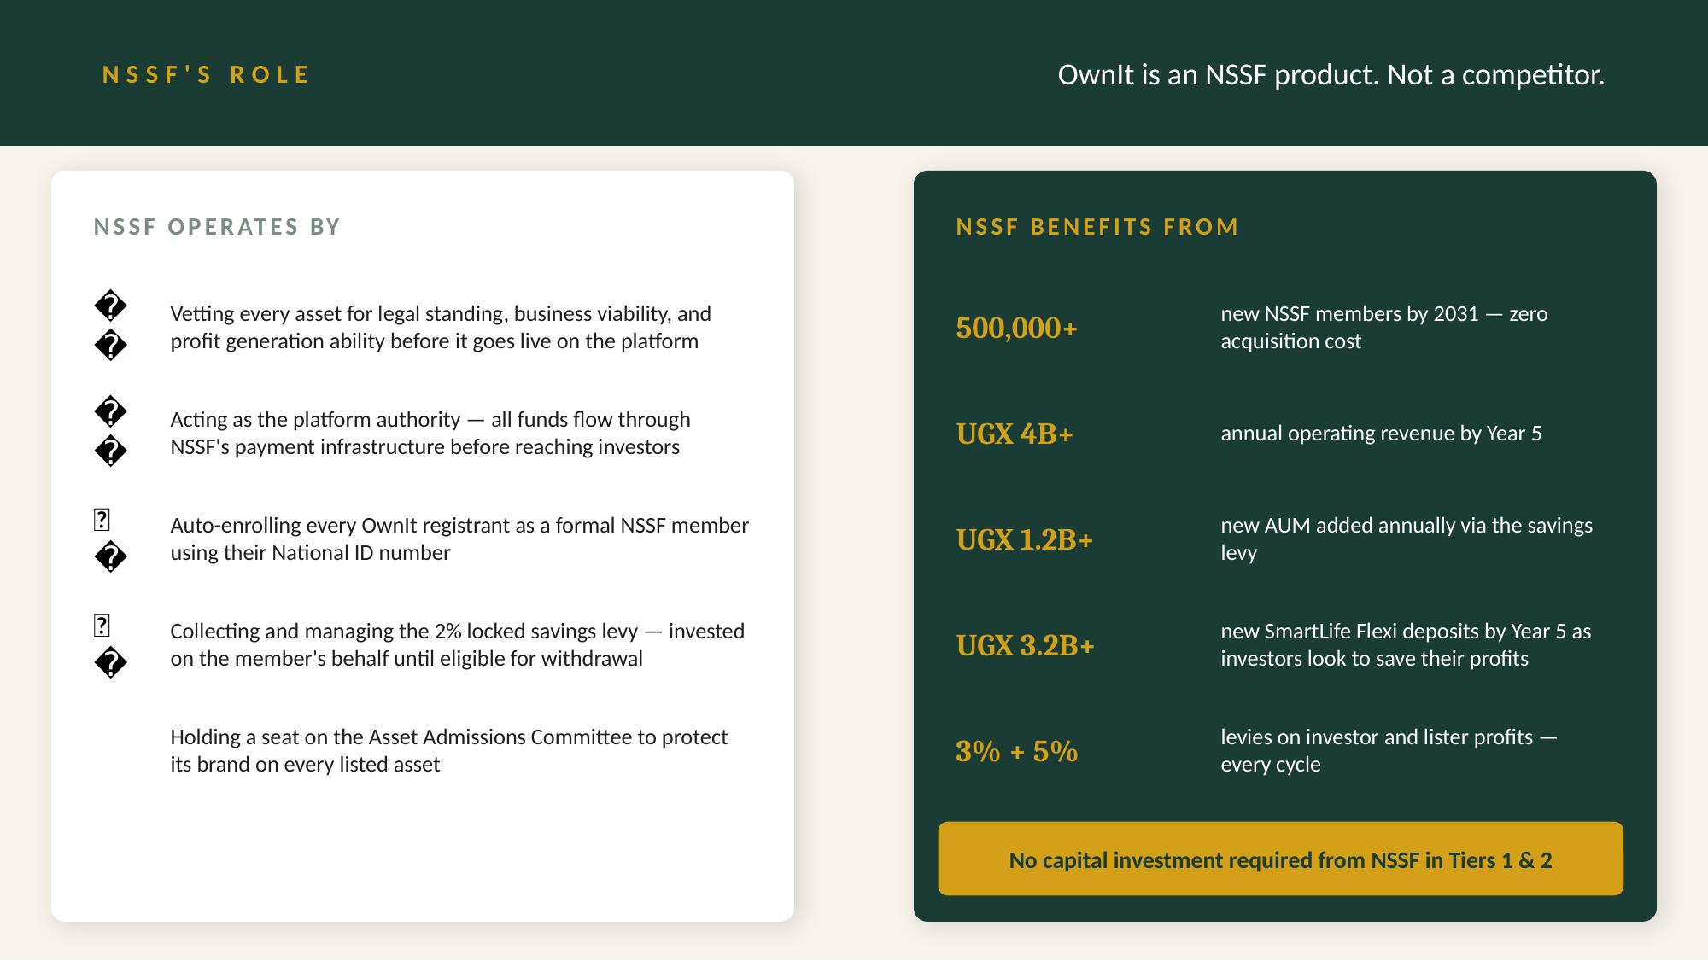


Slide 9
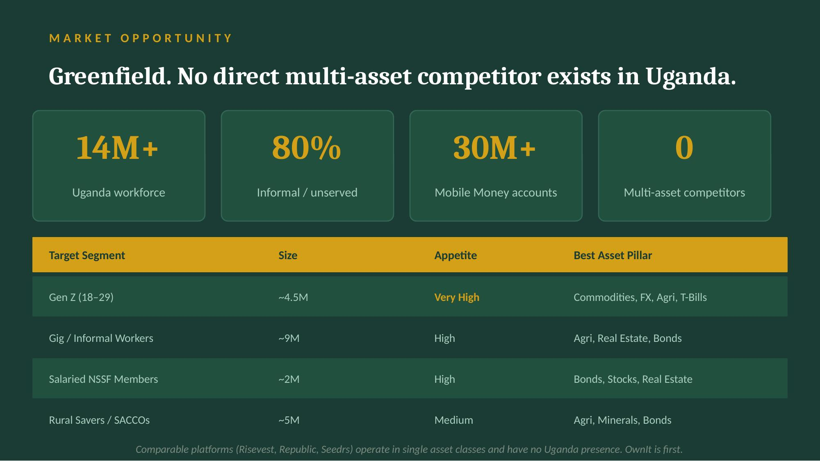

Slide 10
FINANCIAL PROJECTIONS
5-year platform & NSSF revenue model
Metric
Year 1
Year 2
Year 3
Year 5
Active Investors
1M
3M
5M
12M
Platform AUM (UGX B)
10B
50B
200B
500B
NSSF Operating Revenue
153M
678M
2.59M
6.71B
Savings Levy (AUM add)
40M
200M
800M
2.0B+
SmartLife Flexi Deposits
100M
500M
2.0B
5.3B
UGX 500B+
New NSSF Members
1M
3M
5M
12M+
Annual NSSF revenue by Year 5

Slide 11
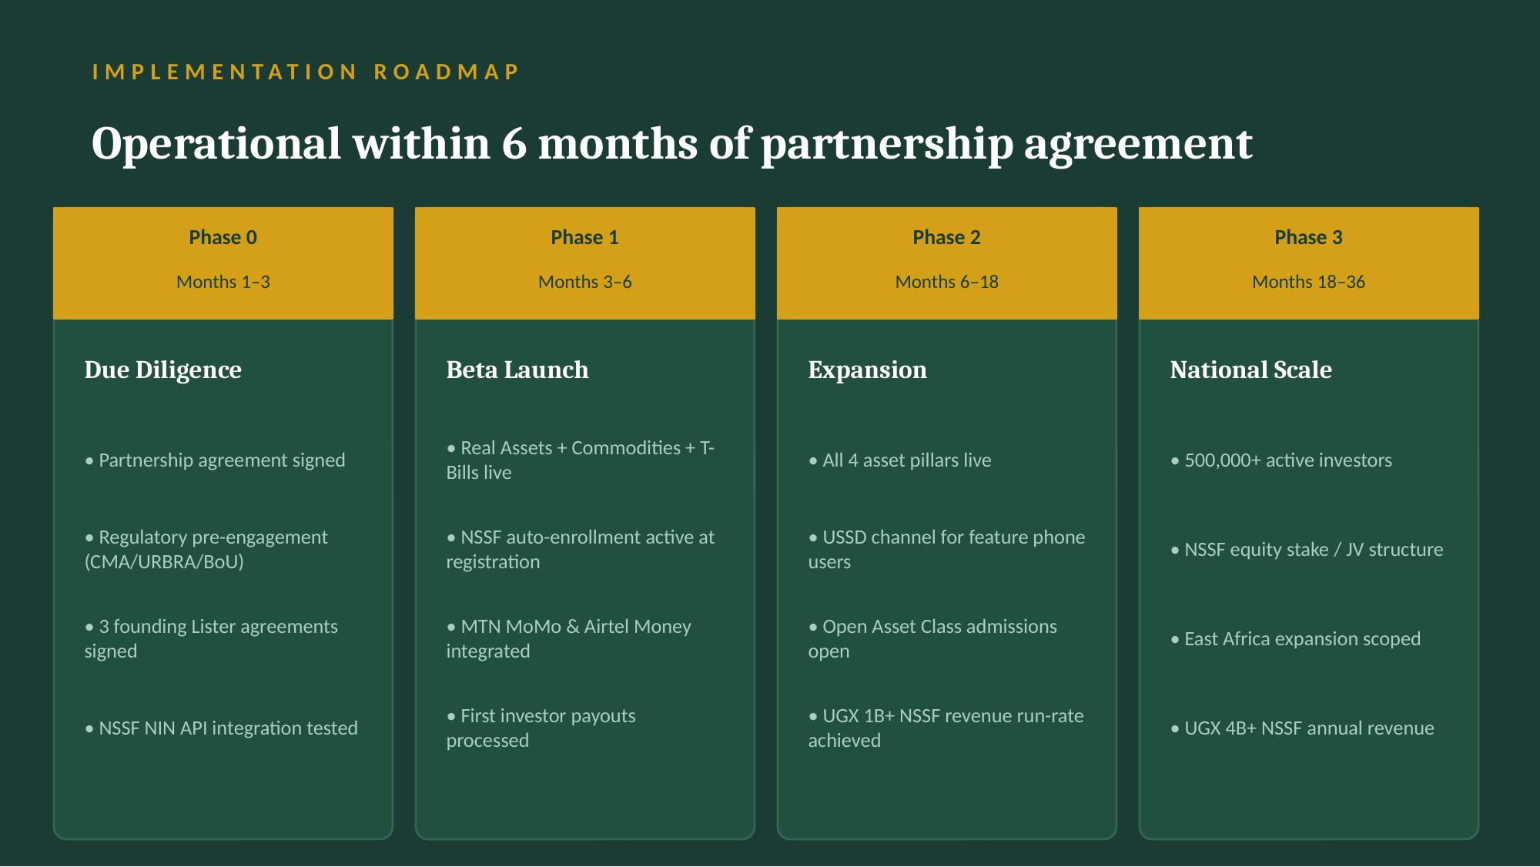

Slide 12
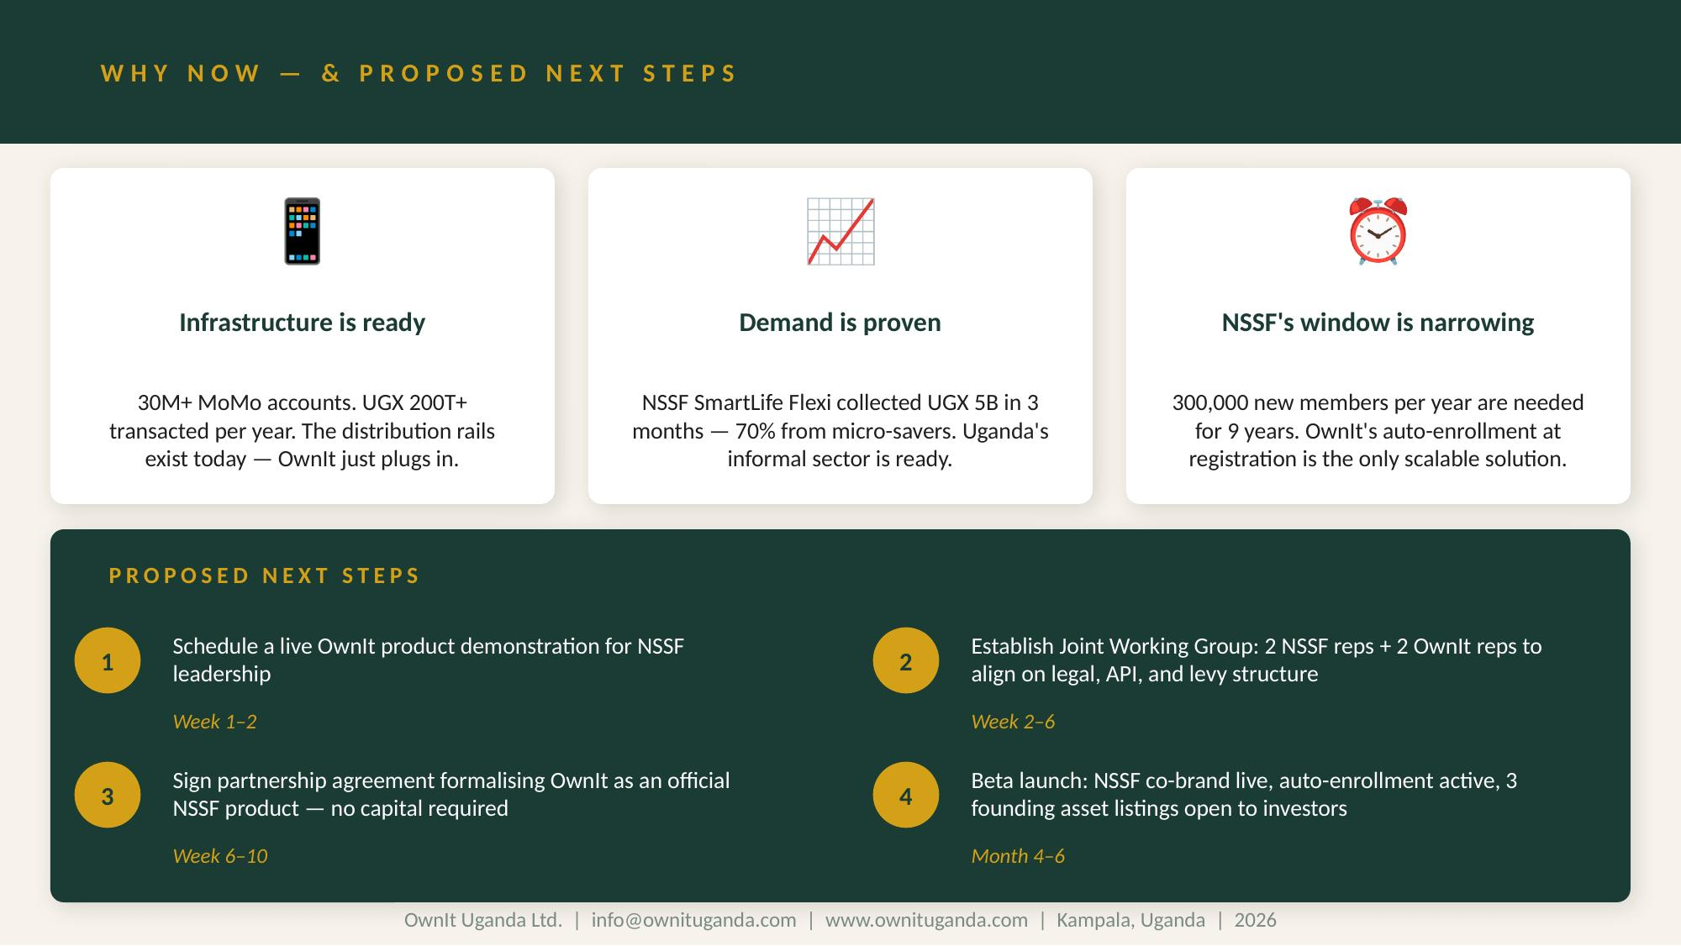

Slide 13
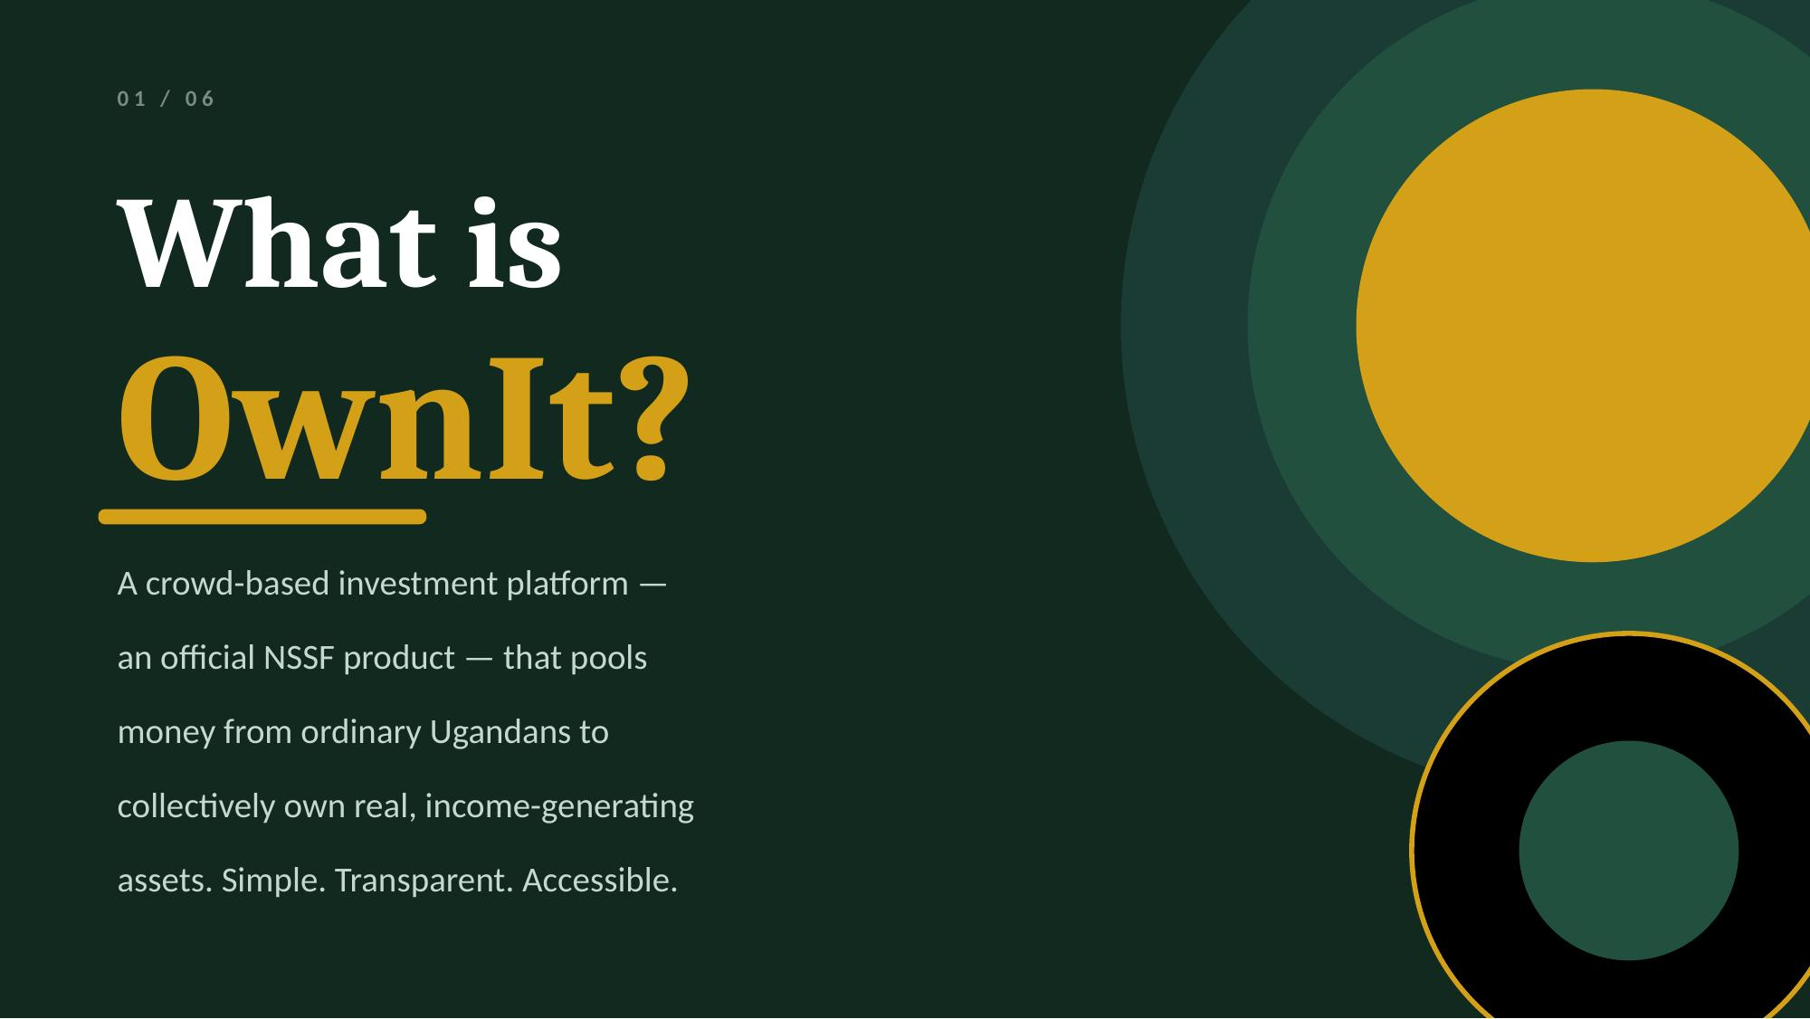

Slide 14
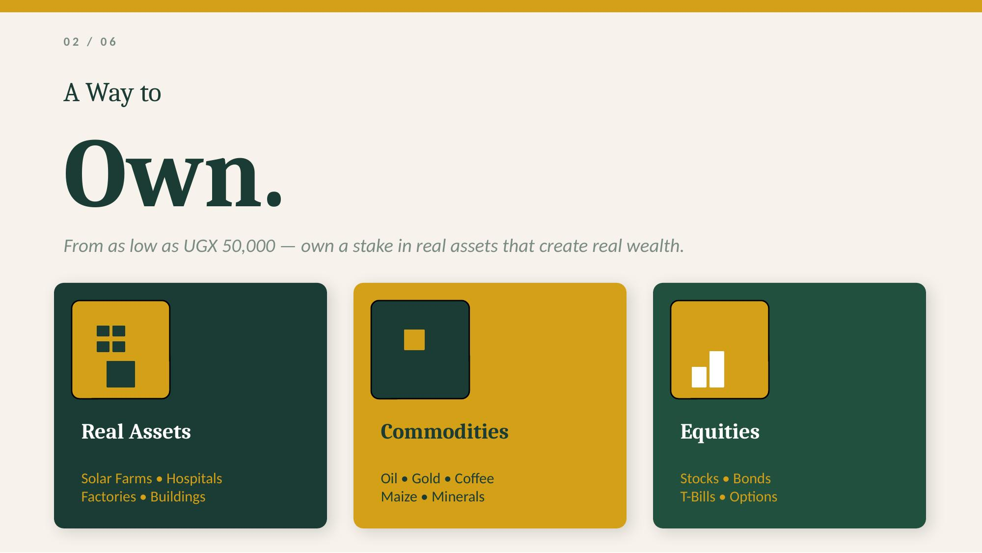

Slide 15
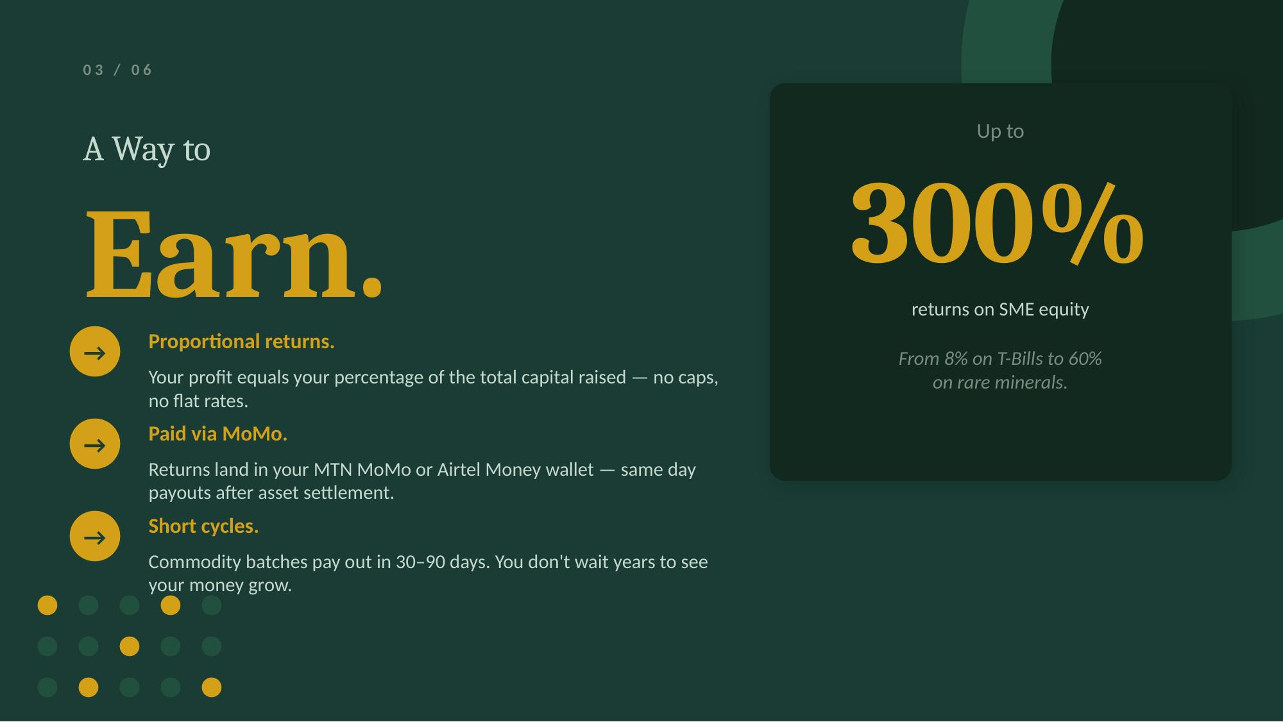

Slide 16
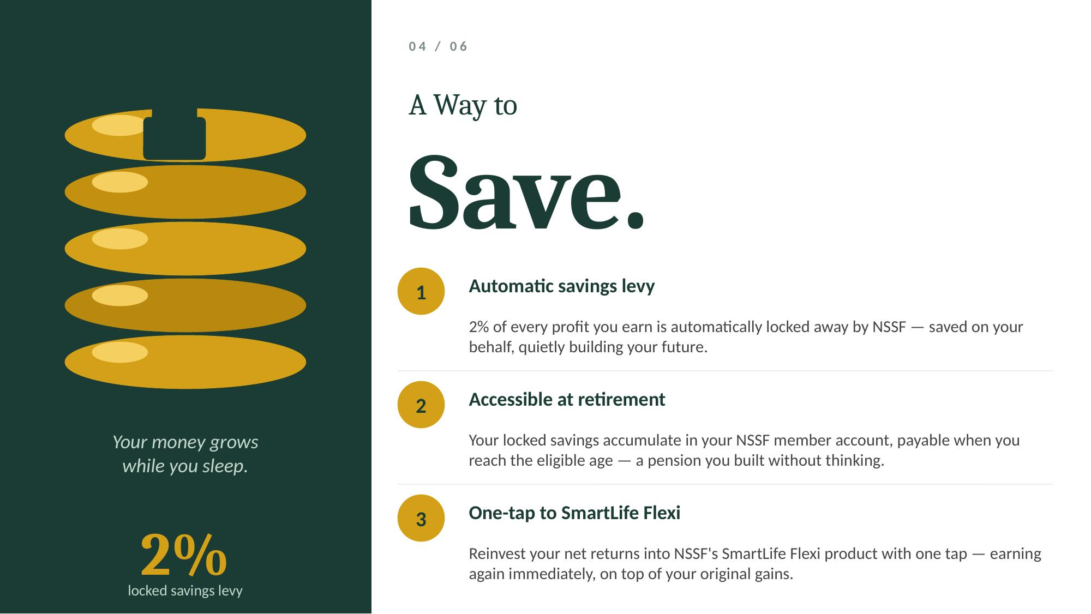

Slide 17
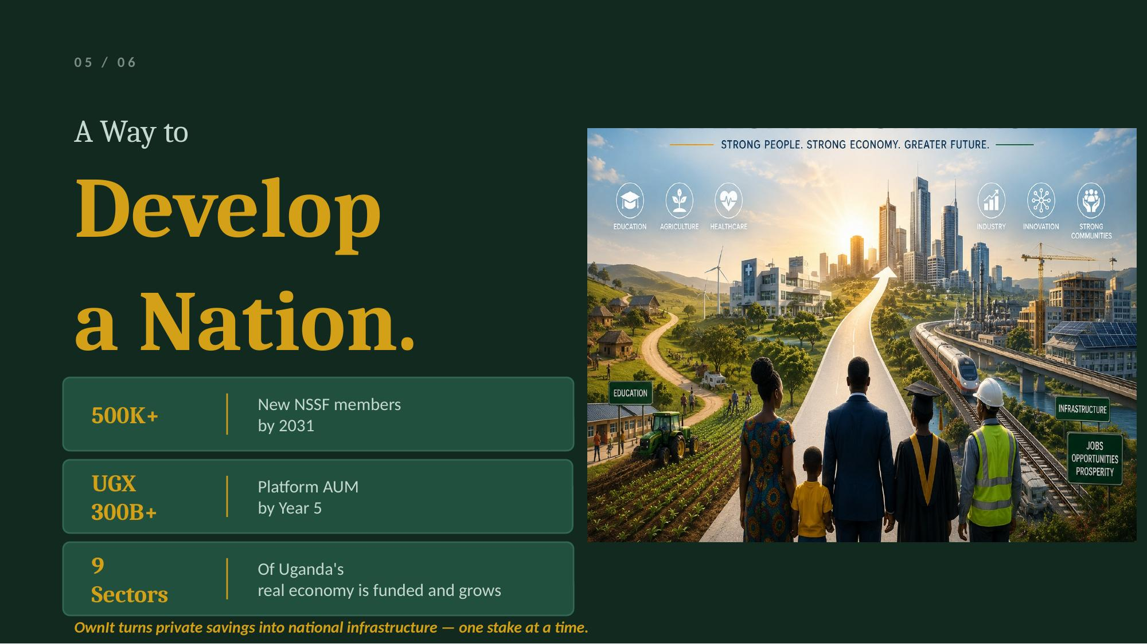

Slide 18


Slide 19
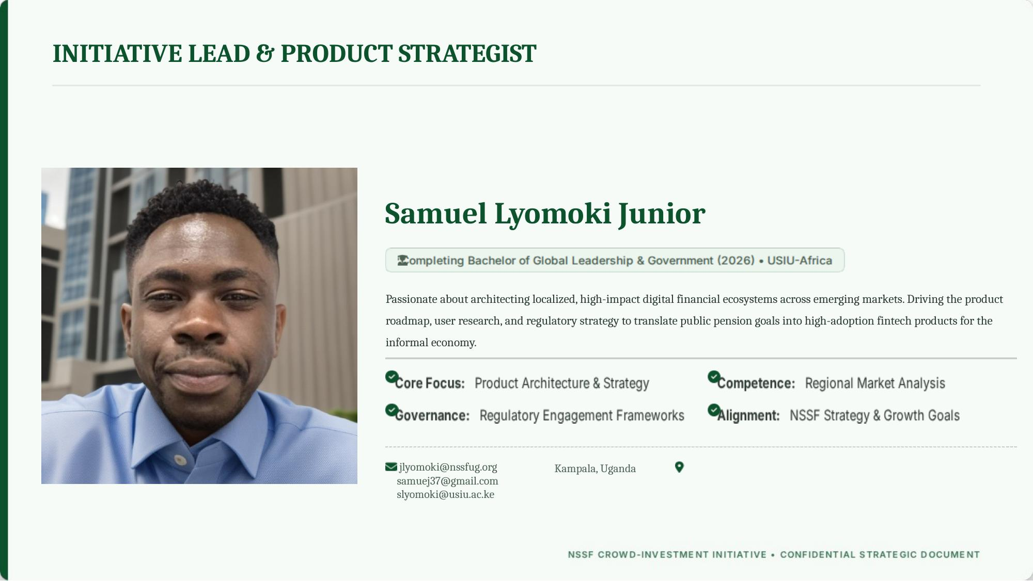

Slide 20
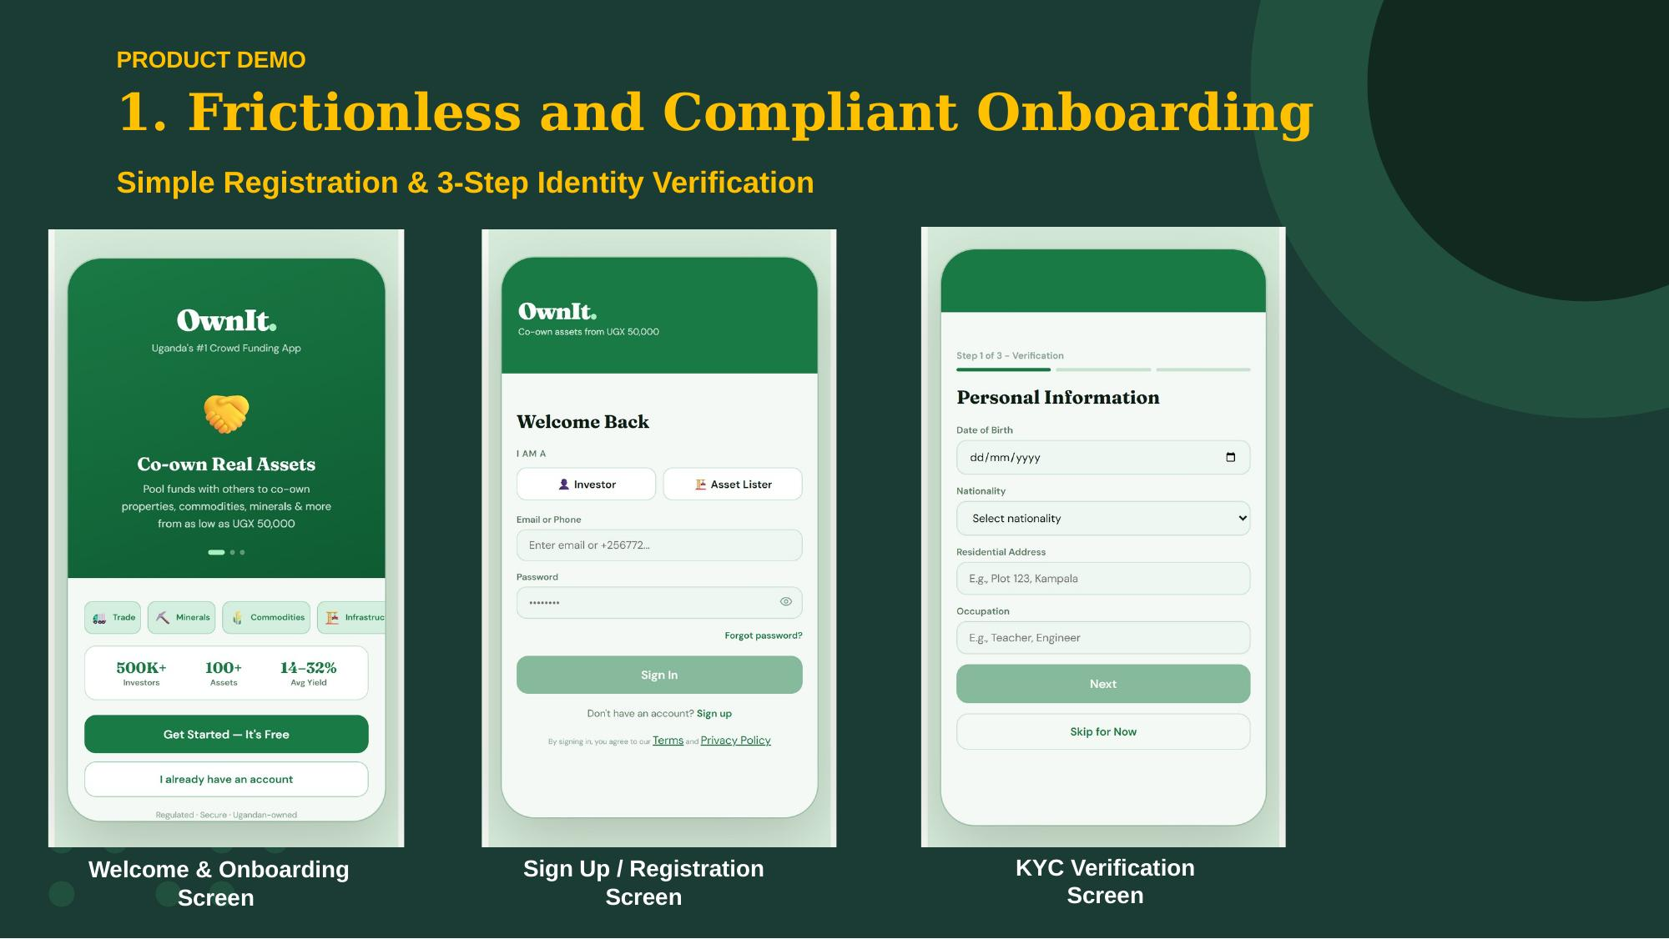

Slide 21


Slide 22
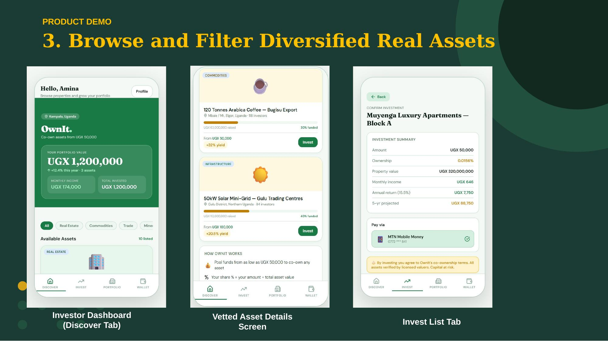

Slide 23
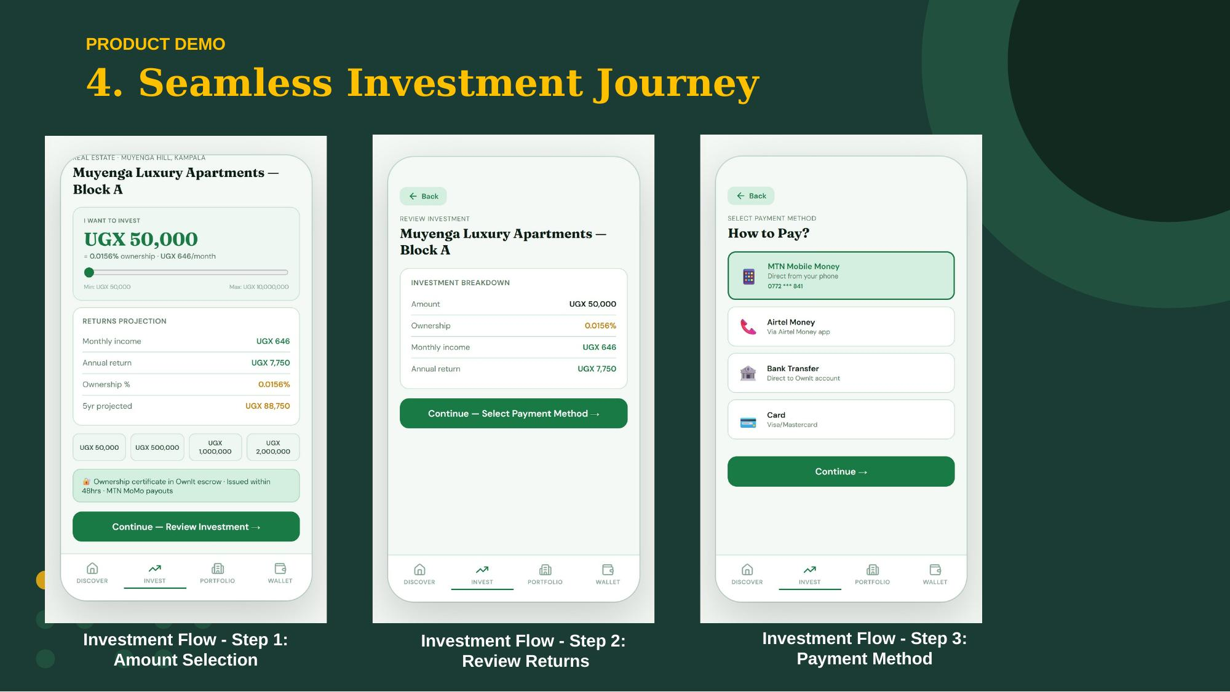

Slide 24
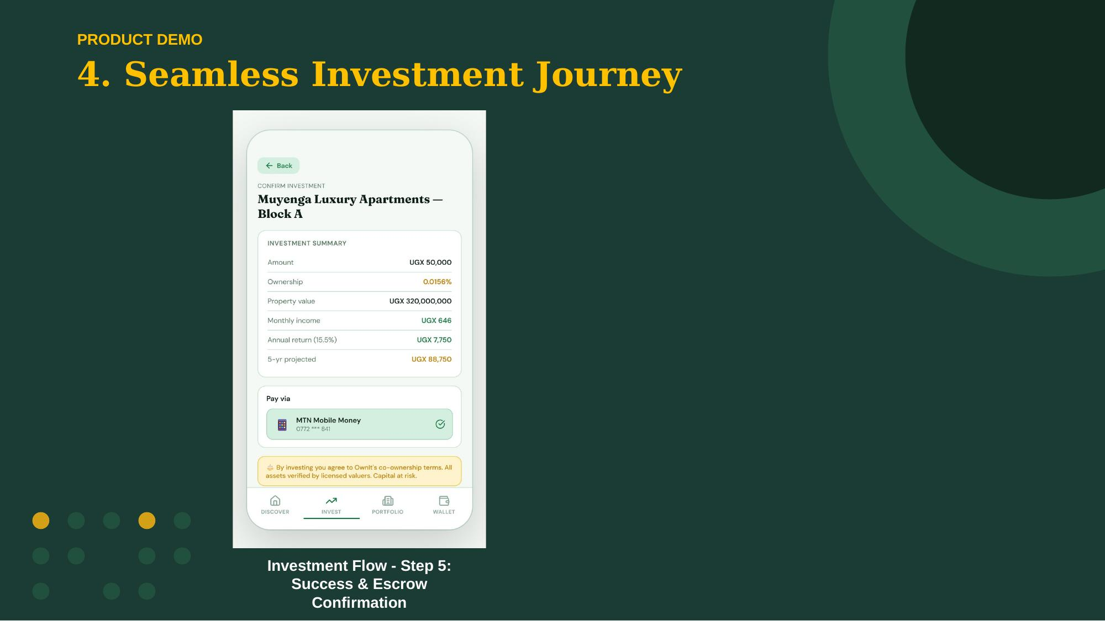

Slide 25
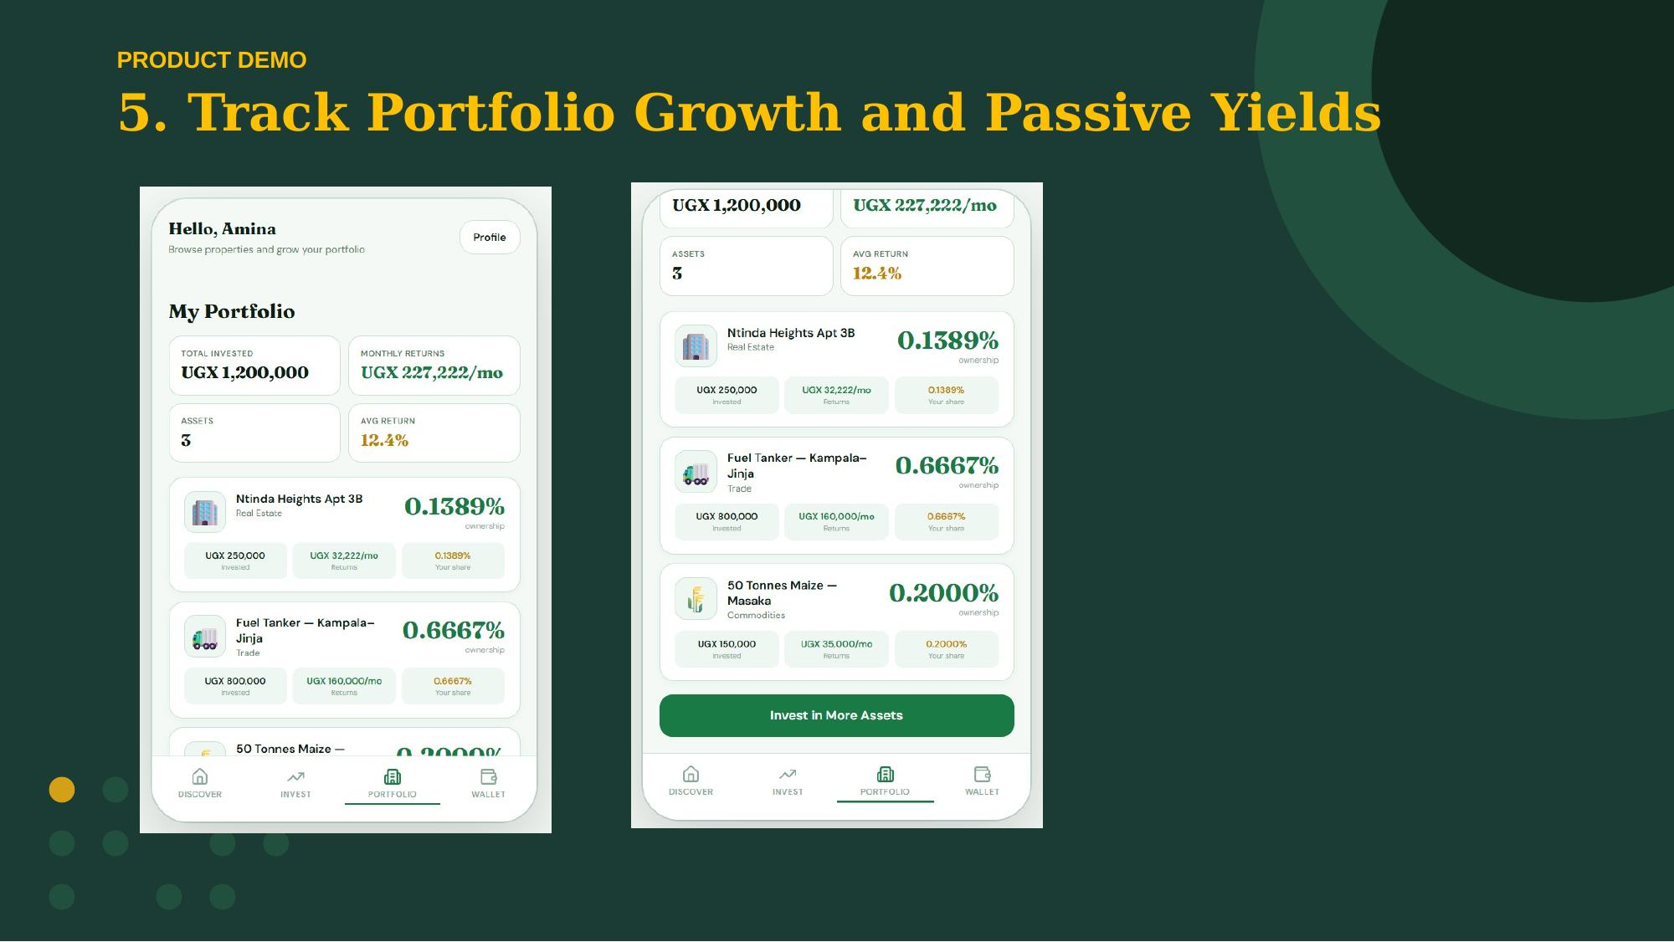

Slide 26
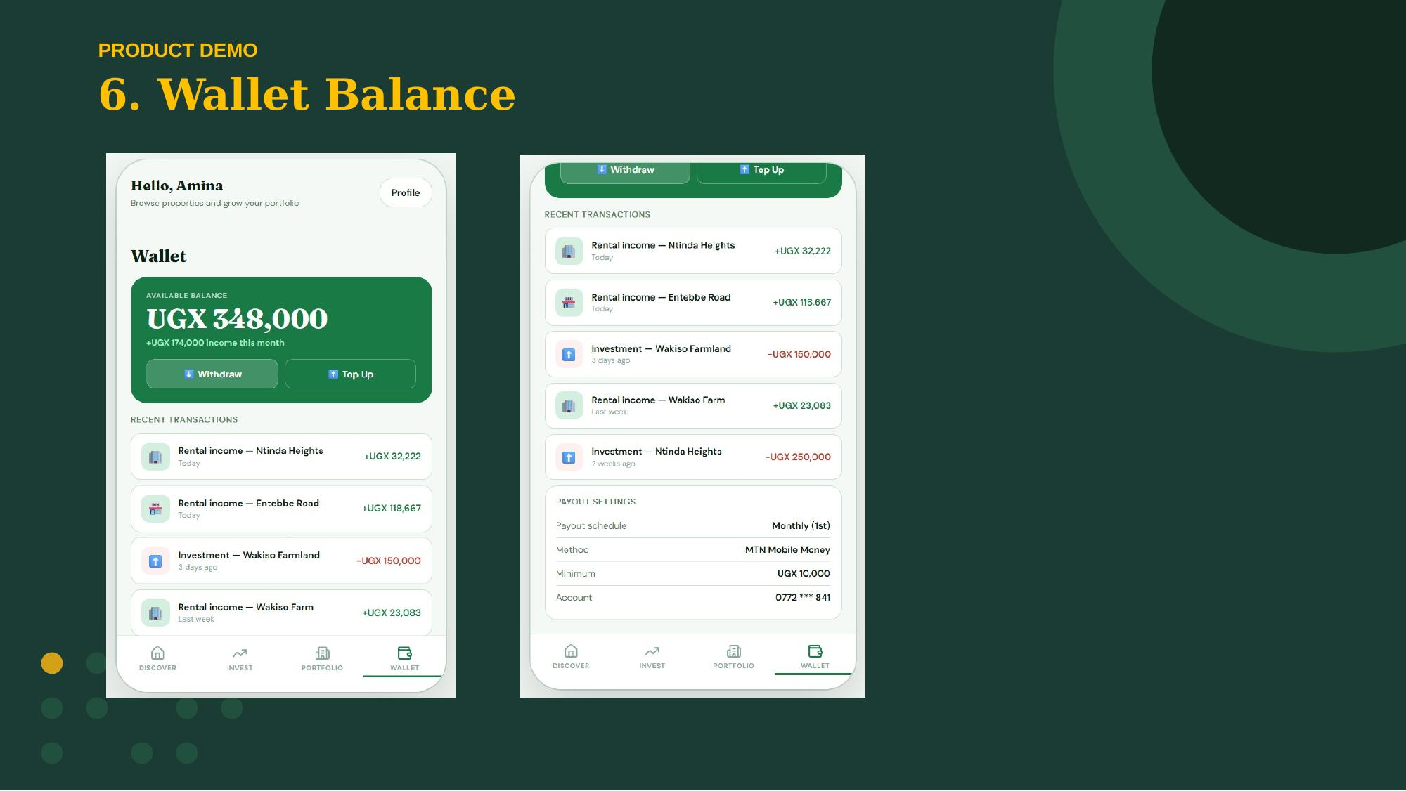

Slide 27
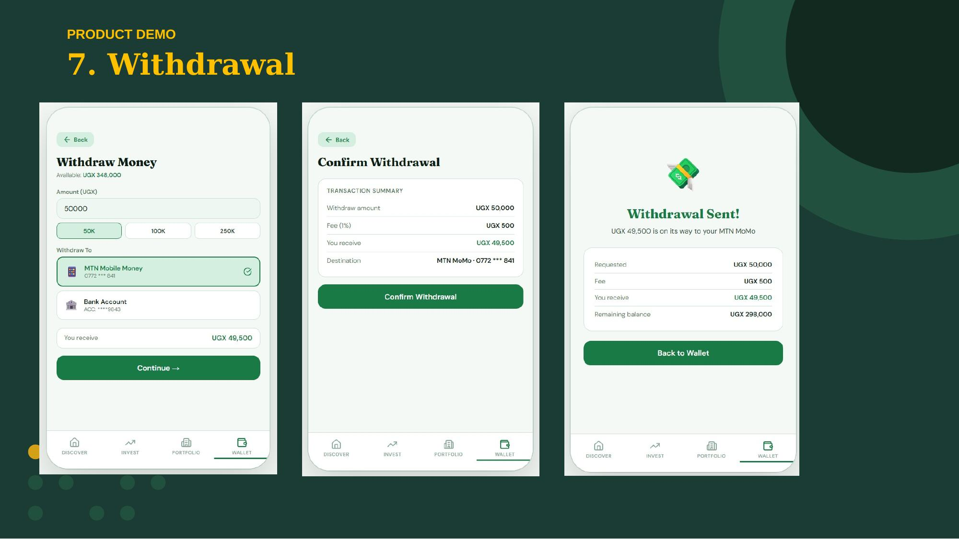

Slide 28
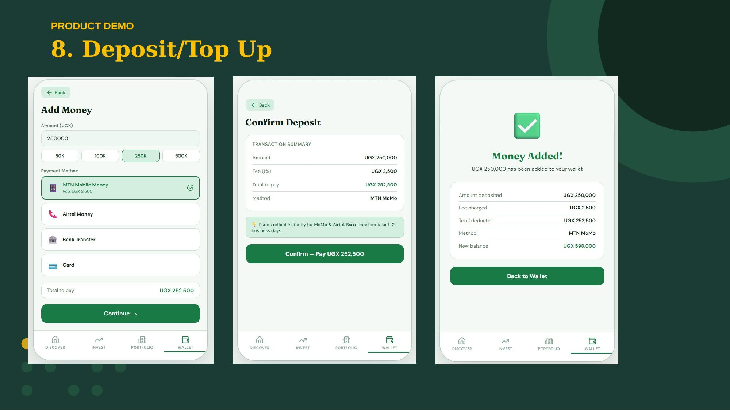

Slide 29
